Slide 1
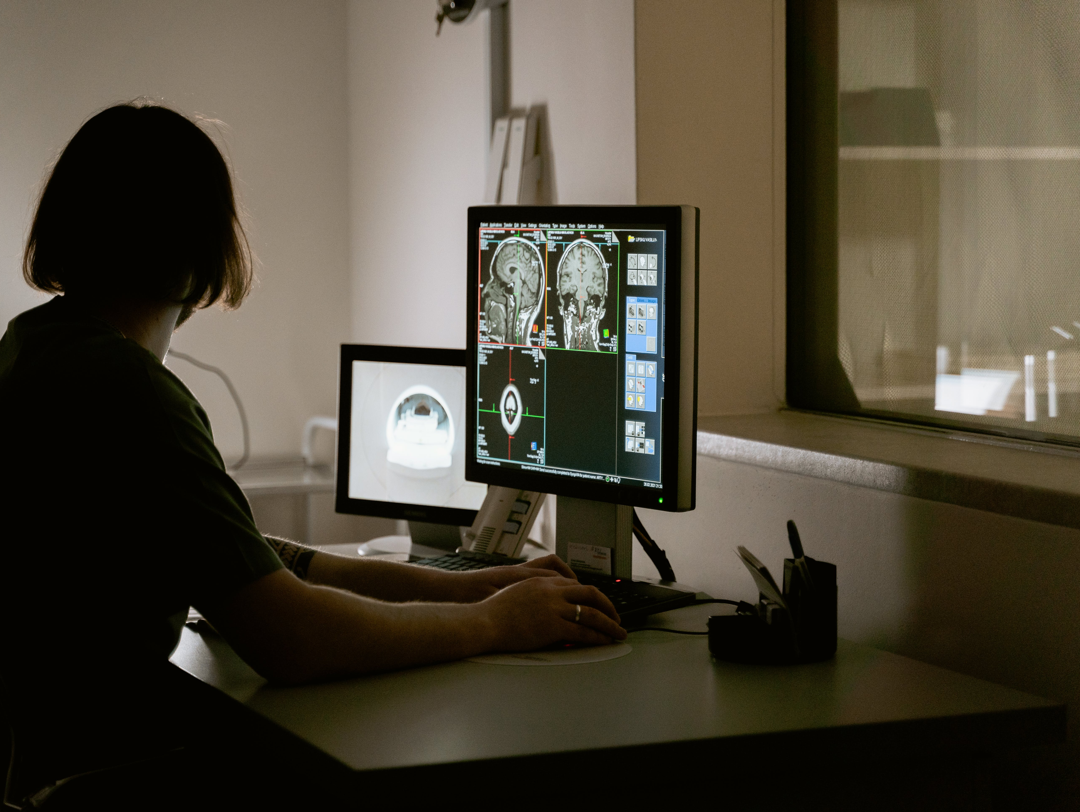
Brain Tumor Detection

Slide 2
Content
Motivation
Introduction
Literature Review
Proposed Methodology
Results
Conclusion
References

Slide 3
Motivation
Brain tumors, a perilous form of cancer, affect individuals across all age groups.
Early detection is vital for better patient outcomes, but traditional methods like eye analysis of MRI data have inherent limitations.
The alarming 300% increase in brain tumor-related deaths over the past 30 years underscores the urgent need for timely identification.
Untreated brain tumors can lead to fatal consequences, emphasizing the critical importance of accurate and non-invasive diagnostic methods.
Magnetic Resonance Imaging (MRI) stands out as the most effective tool for diagnosing brain cancers.

Slide 4
Introduction
Recent advancements in machine learning, particularly deep learning, enable precise recognition of medical imaging patterns.
This study employs diverse machine-learning techniques, including a convolutional neural network with data augmentation and feature extraction, on a substantial MRI dataset.
Evaluation of multiple machine-learning models on a dataset comprising 3284 brain tumor (MRI) images provides nuanced insights into their performance.
This research significantly contributes to ongoing endeavors in brain tumor detection, utilizing state-of-the-art machine learning and deep learning techniques, and the results are rigorously compared with existing literature to advance our understanding of effective approaches in brain tumor detection.

Slide 5
Literature Review
Refernces | Models | Accuracy Rate
Malarvizhi et al.(2022) | K-means clustering, SVM classification | 80%
Md. Saikat Islam Khan (2022) | 23-layer CNN, Fine-tuned CNN with VGG16 | 97.8%, 100%
Divyamary.D and Gopika.S, (2020) | Naive Bayes Classifier | 84%
Rajni H et al., (2020) | Naive Bayes Classifier | 94%
Ramdas Vankdothu and Mohd Abdul Hameed, (2022) | Hybrid ANFIS and SVM, FCM segmentation, GWO, SSO, GA | 99.24%

Slide 6
Influence from Previous Work: MRI-based Brain Tumor Detection
Previous Study
Title: “MRI-based Brain Tumor Detection using Convolutional Deep Learning Methods” (2023)
Methodology:
Dataset: 3264 MRI images (glioma, meningioma, pituitary tumors, healthy brains)
Techniques: 2D CNN, Auto-encoder Network, Machine Learning (MLP, KNN)
Results:
Acuracy: 2D CNN (93%), Auto-encoder (90%)
KNN achieved the highest ML accuracy (86%)

Slide 7
Our Contributions
Overview
Extending prior work, our study implements state-of-the-art ML and deep learning algorithms.
Results
Improved accuracy, efficiency, and applicability in diverse scenarios.
Comparison:
Highlight key improvements or differences
Make predictions
Use visuals to enhance understanding

Slide 8
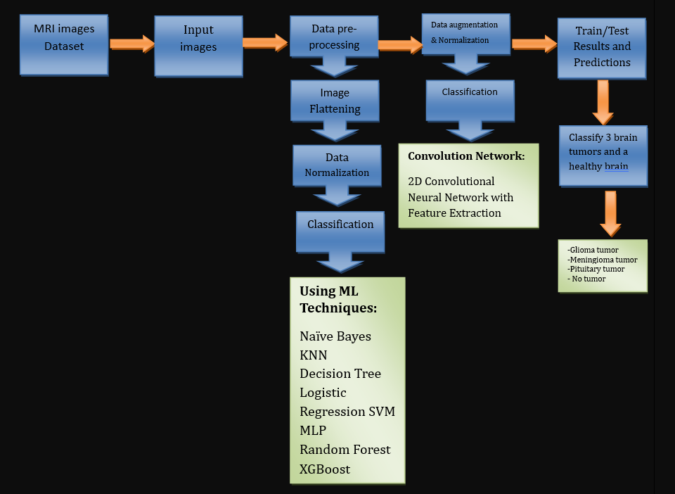
Proposed Methodology

Slide 9
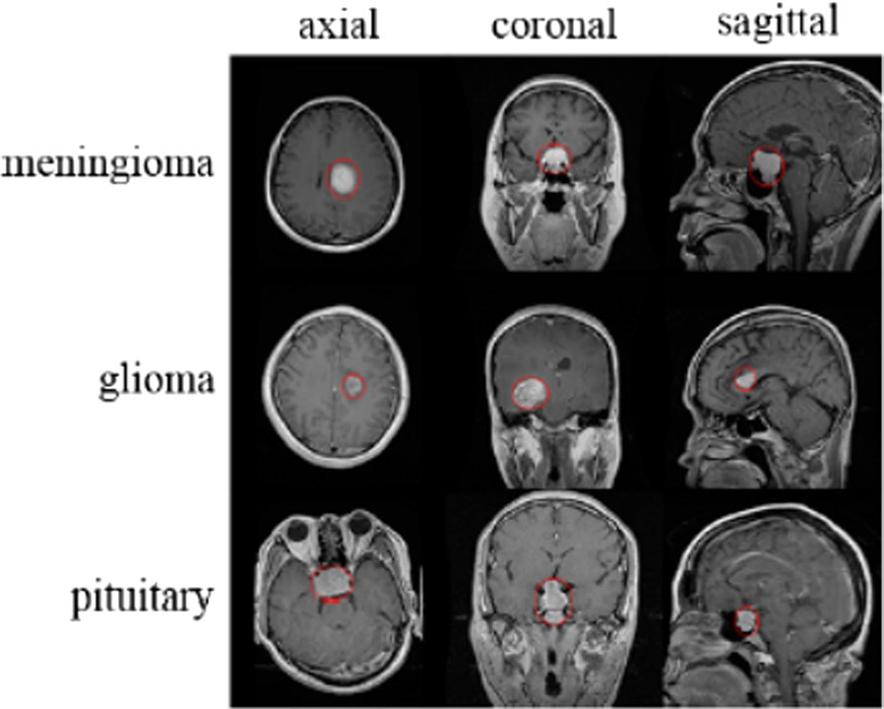
Dataset Overview
Dataset Information: Total Images: 3284 brain tumor (MRI) images
Dataset after up-sampling: 3788
Data Split: Applied an 80-20 train-test split. Train (3030) and Test (758)
Source: Publicly available dataset on Kaggle
MRI Images of Four Classes:
No tumor (Healthy Brain)
Meningioma Tumor
Pituitary Gland Tumor
Glioma Tumor

Slide 10
Machine Learning Models
Naive Bayes: Limited performance suggesting simplicity may not capture complex data patterns effectively.
KNN (K-Nearest Neighbors): Solid, balanced performance across metrics.
Decision Tree: Balanced performance in accuracy, recall, precision, and F1.
Logistic Regression: Consistent, robust performance. Simple and interpretable, suitable for various tasks.
SVM (Support Vector Machine): Strong overall performance. Effective for both linear and non-linear patterns.
MLP (Multi-Layer Perceptron): High accuracy and balanced metrics.
Random Forest: Excellent overall performance with high metrics. The ensemble approach enhances robustness.
XGBoost: Top-tier performance with high accuracy and balanced metrics. Gradient boosting optimizes generalization.

Slide 11
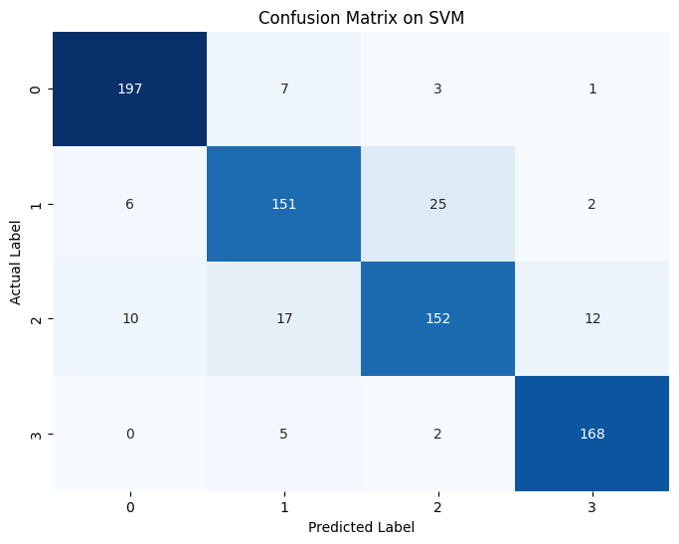
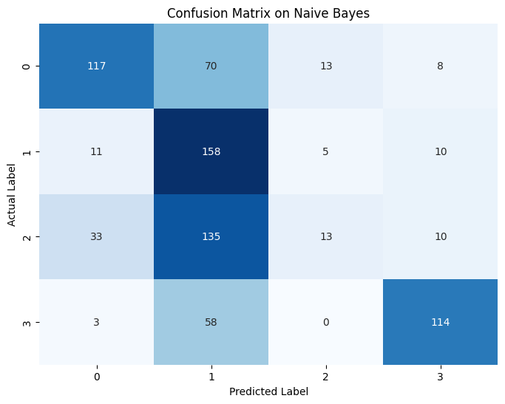
Confusion Matrix of ML Models 1/4
No tumor: 0,
Glioma tumor: 1,
Meningioma Tumor: 2,
Pituitary Tumor: 3
SVM Confusion Matrix
Naïve Bayes Confusion Matrix

Slide 12
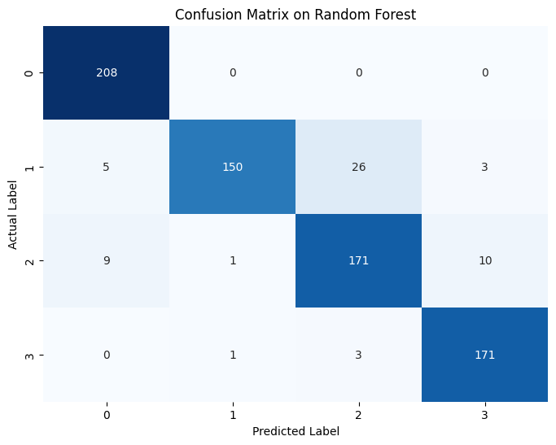
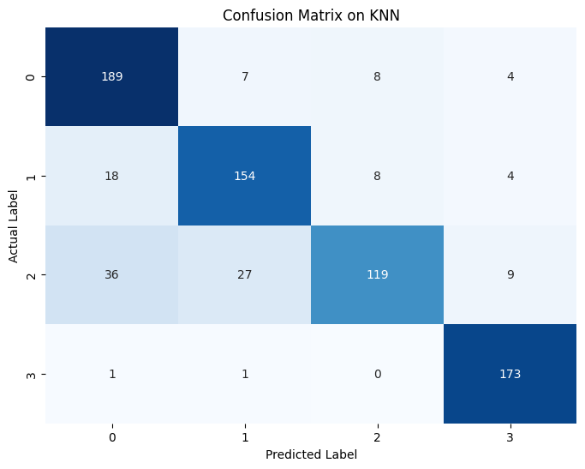
Confusion Matrix of ML Models 2/4
No tumor: 0,
Glioma tumor: 1,
Meningioma Tumor: 2,
Pituitary Tumor: 3
Random Forest Confusion Matrix
K-NN Confusion Matrix

Slide 13


Confusion Matrix of ML Models 3/4
No tumor: 0,
Glioma tumor: 1,
Meningioma Tumor: 2,
Pituitary Tumor: 3
Logistic Regression Confusion Matrix
XGBoost Confusion Matrix

Slide 14
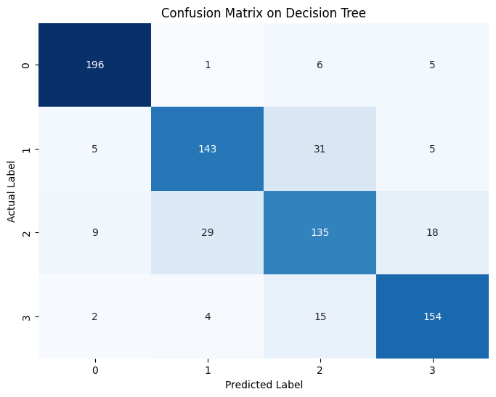
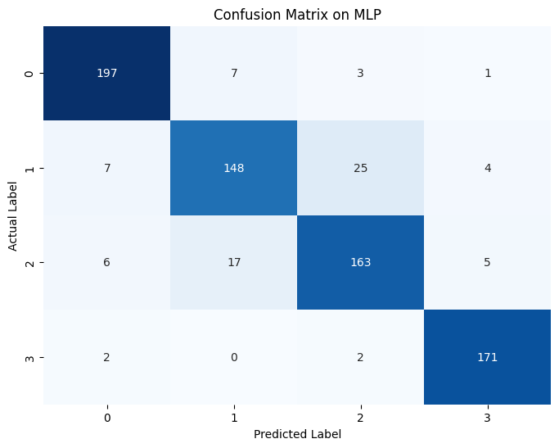
Confusion Matrix of ML Models 4/4
No tumor: 0,
Glioma tumor: 1,
Meningioma Tumor: 2,
Pituitary Tumor: 3
Decision Tree Confusion Matrix
Multilayer Perceptron Confusion Matrix

Slide 15
Results on Machine Learning Models
Model | Accuracy | Avg Recall | Avg Precision | F1 Score
Naive Bayes | 53% | 0.54 | 0.58 | 0.5
KNN | 84% | 0.84 | 0.85 | 0.84
Decision Tree | 83% | 0.83 | 0.83 | 0.83
Logistic Regression | 88% | 0.88 | 0.88 | 0.88
SVM | 88% | 0.88 | 0.88 | 0.88
MLP | 90% | 0.9 | 0.89 | 0.89
Random Forest | 92% | 0.92 | 0.93 | 0.92
XGBoost | 92% | 0.92 | 0.93 | 0.92

Slide 16
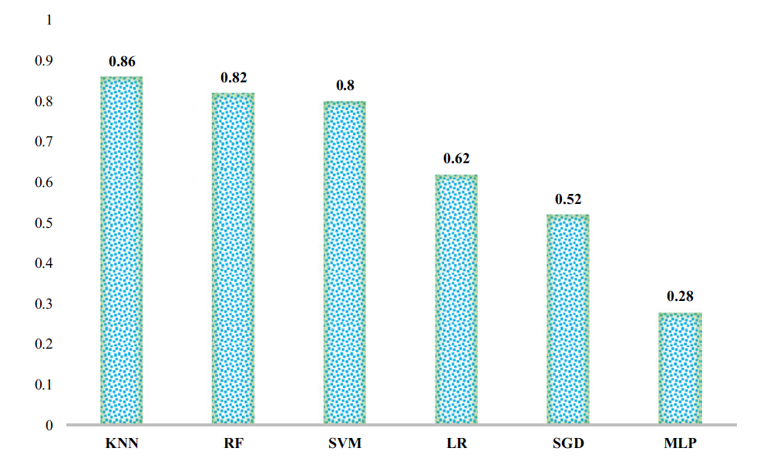
Comparative Analysis
Results we have achieved
Results from paper, [Saeedi et al., (2023)]

Slide 17
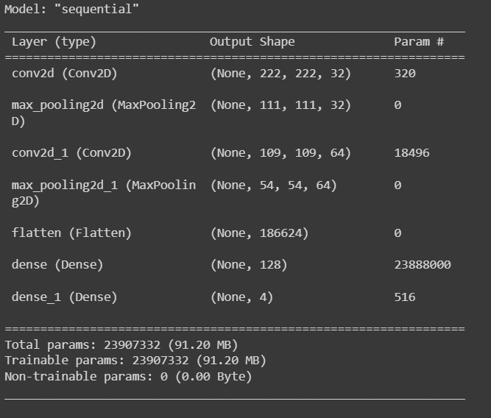
Convolutional Neural Network (CNN)
Model Architecture:
Sequential model with distinct layers.
Conv2D Layers: Utilized 32 filters of 3x3 kernels with ReLU activation.
Max Pooling Layers: Applied 2x2 max pooling to reduce spatial dimensions.
Flattened Layer: Transformation of output into a 1D array.
ReLU Activation: Introduced non-linearity for better generalization on complex data.
Output Layer: Comprised of 4 neurons with softmax activation for multi-class classification.
Model Compilation:
Optimizer: Adam optimizer employed.
Loss Function: sparse_categorical_crossentropy chosen based on existing literature.

Slide 18
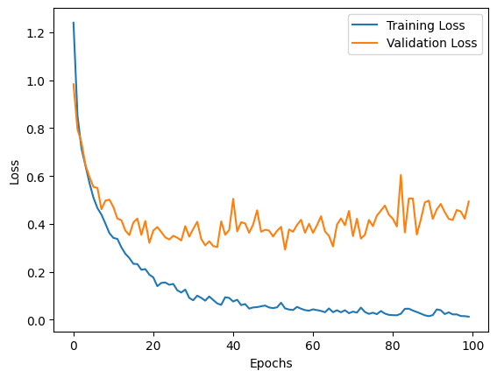
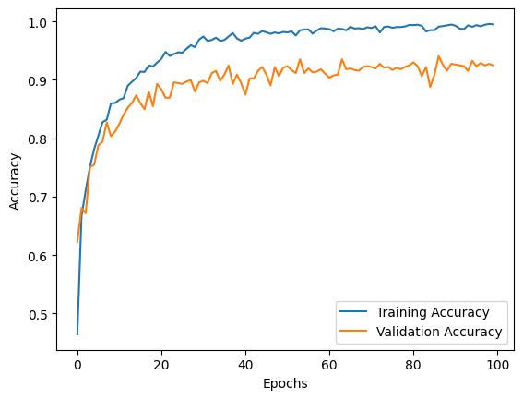
Results on CNN
On CNN we got 93% accuracy

Slide 19
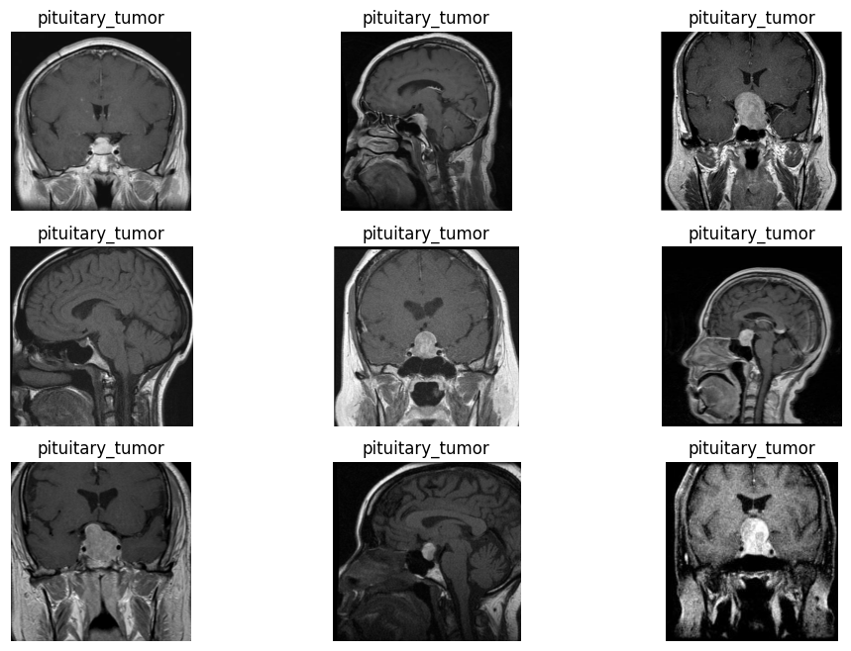
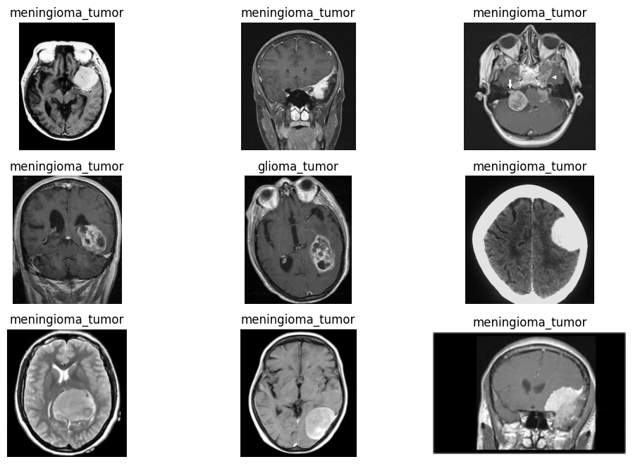
Model Predictions
Actual Images: Pituitary Tumor
Actual Images: Meningioma Tumor

Slide 20
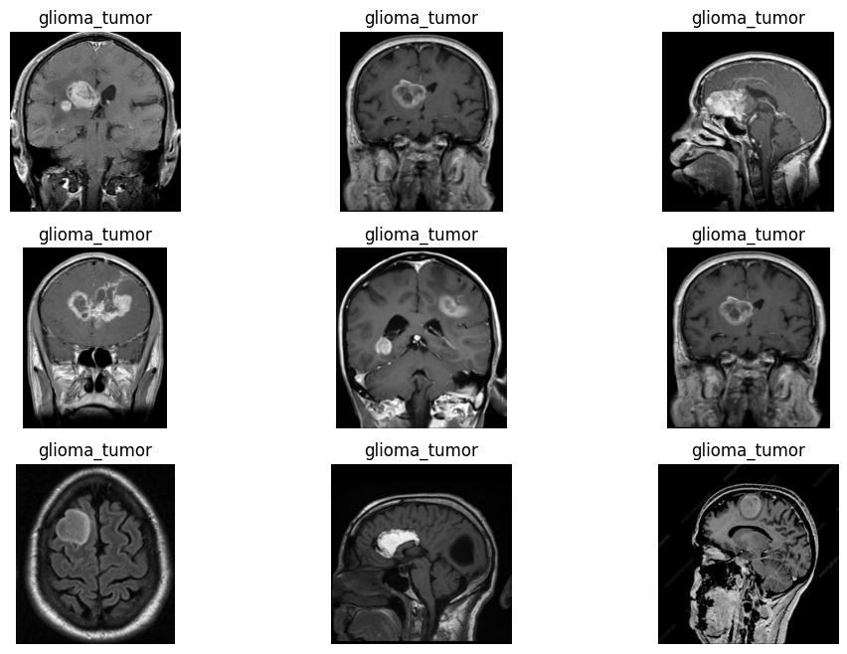
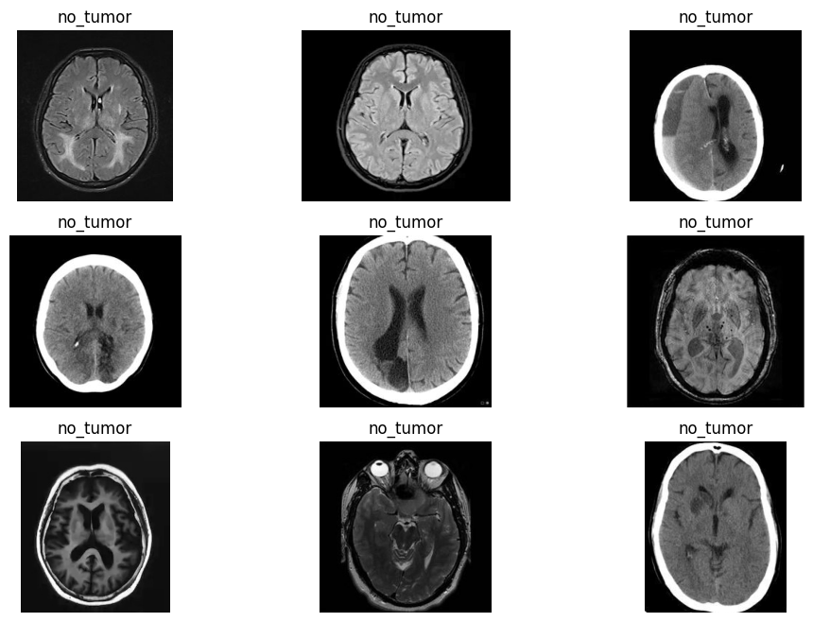
Model Predictions
Actual Images: Glioma Tumor
Actual Images: No Tumor

Slide 21
Summary
Machine Learning Models:
Naive Bayes and KNN showed lower performance.
Decision Tree, Logistic Regression, SVM, MLP, Random Forest, and XGBoost demonstrated varying levels of accuracy.
Top performers were Random Forest and XGBoost.
Convolutional Neural Network (CNN):
Achieved a high accuracy of 93%.
Outperformed traditional ML models on image data.

Slide 22
References 1/2
El-Dahshan, E. S. A., Mohsen, H. M., Revett, K., & Salem, A. B. M. (2014). Computer-aided diagnosis of human brain tumor through MRI: A survey and a new algorithm. Expert Systems with Applications, 41(11), 5526–5545.
Badža, M. M., & Barjaktarović, M. Č. (2020). Classification of brain tumors from MRI images using a convolutional neural network. Applied Sciences, 10(6), 1999.
Divyamary, D., Gopika, S., Pradeeba, S., & Bhuvaneswari, M. (2020, March). Brain tumor detection from MRI images using Naive classifier. In 2020 6th international conference on advanced computing and communication systems (ICACCS) (pp. 620-622). IEEE.
H, R., B, S., Reddy, V. K., & M, V. S. (2020). Brain Tumor Detection using Naïve Bayes Classification. International Research Journal of Engineering and Technology (IRJET), 07(06), 6851.
Malarvizhi, A. B., Mofika, A., Monapreetha, M., & Arunnagiri, A. M. (2022, August). Brain tumour classification using machine learning algorithm. In Journal of Physics: Conference Series (Vol. 2318, No. 1, p. 012042). IOP Publishing.

Slide 23
References 2/2
Vankdothu, R., & Hameed, M. A. (2022). Brain tumor segmentation of MR images using SVM and fuzzy classifier in machine learning. Measurement: Sensors, 24, 100440.
Khan, M. S. I., Rahman, A., Debnath, T., Karim, M. R., Nasir, M. K., Band, S. S., ... & Dehzangi, I. (2022). Accurate brain tumor detection using deep convolutional neural network. Computational and Structural Biotechnology Journal, 20, 4733-4745.
Saeedi, S., Rezayi, S., Keshavarz, H., & R. Niakan Kalhori, S. (2023). MRI-based brain tumor detection using convolutional deep learning methods and chosen machine learning techniques. BMC Medical Informatics and Decision Making, 23(1), 16.
Sartaj. (2020). Brain tumor classification (MRI). Retrieved from https://www.kaggle.com/datasets/sartajbhuvaji/brain-tumor-classification-mri?select=Training

Slide 24
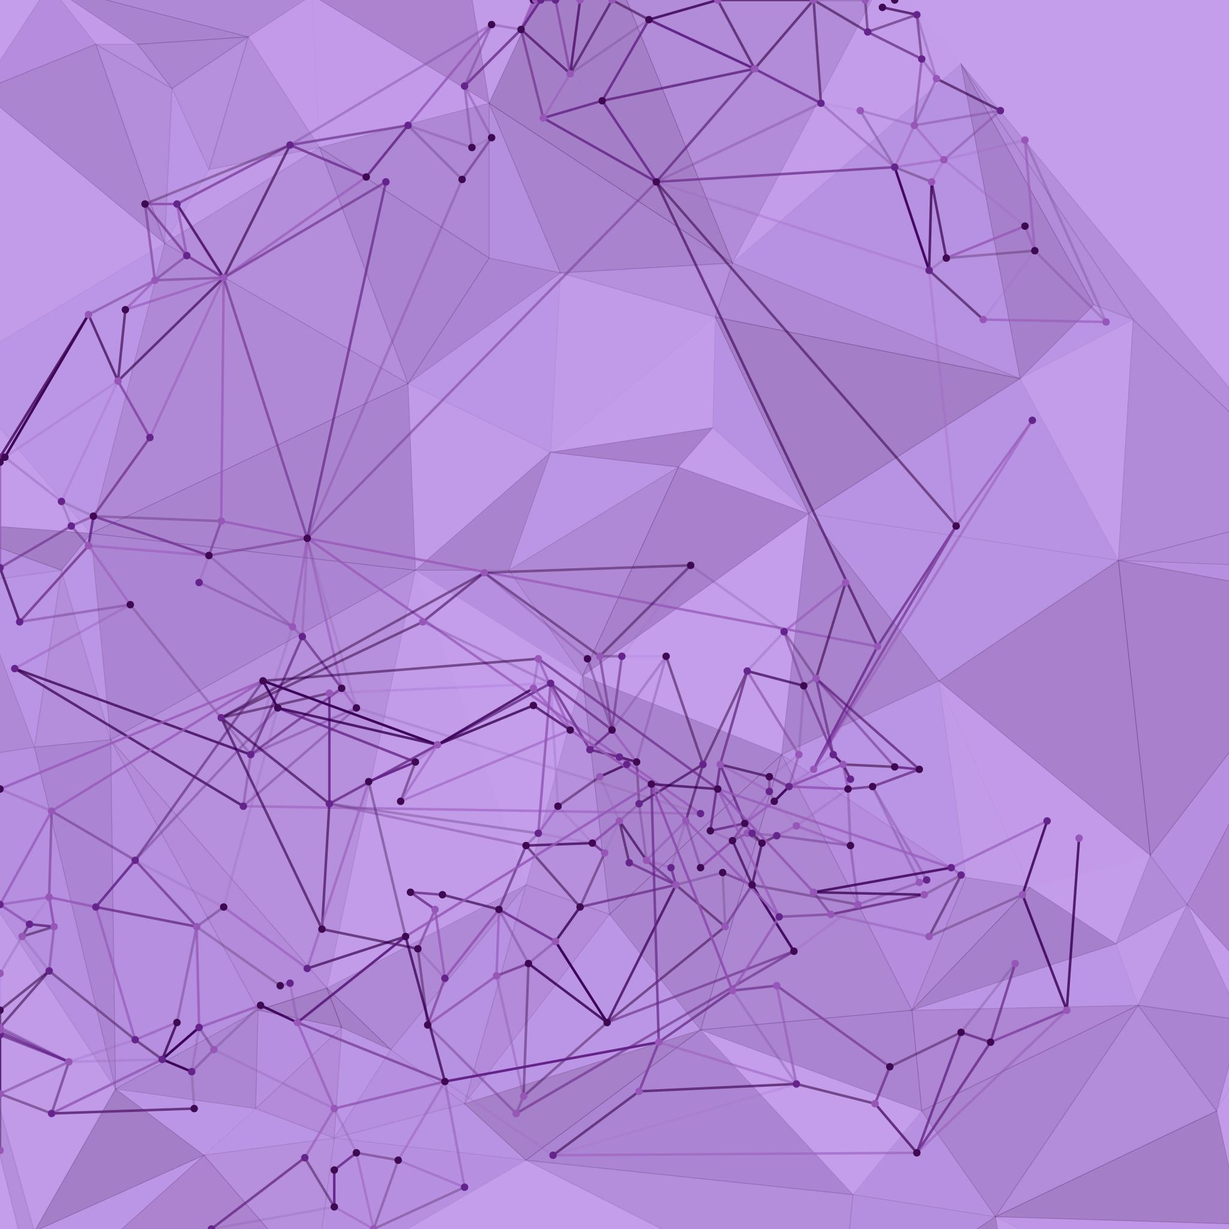
Thank you for your attention.

